Slide 1
FIN 580 HW3 Presentation
Emanuel Scoullos
Yaojun Yu

Slide 2
Methodology

Slide 3
Data Description & Cleaning
We assumed that a day starts from 4:05 pm and ends at 4:00 pm on the next calendar day. Thus, we assumed that the number of trading days in a year to be 252.
We assumed that a week starts from 4:05 pm on Sunday and ends at 4:00 pm on Friday. Thus, we assumed that the number of trading weeks in a year to be 52.
Methodology

Slide 4
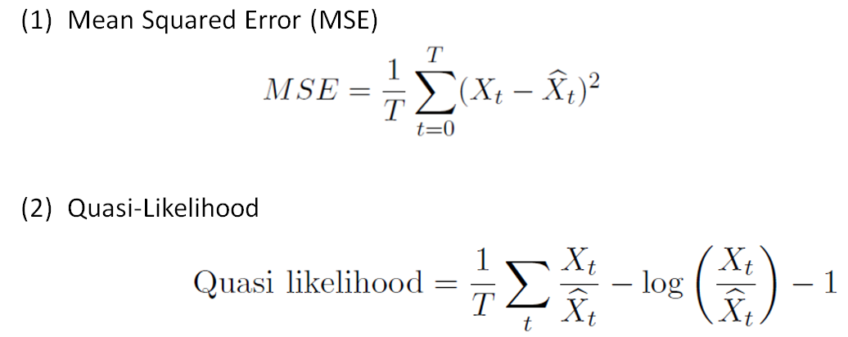
Performance Measurement
Methodology

Slide 5
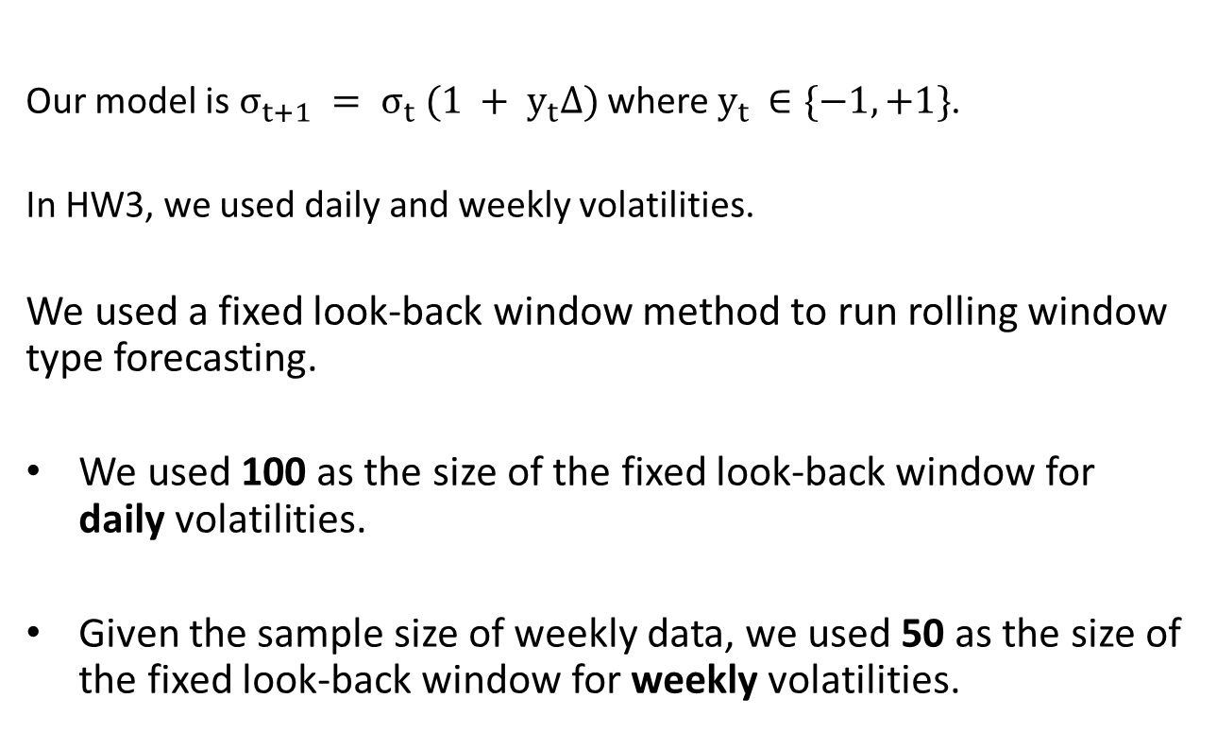
Model
Our model is $σ_{t+1} = σ_{t} (1 + y_{t}∆)$ where $y_{t }∈\{−1,+1\}$.
In HW3, we used daily and weekly volatilities.
We used a fixed look-back window method to run rolling window type forecasting.
We used 100 as the size of the fixed look-back window for daily volatilities.
Given the sample size of weekly data, we used 50 as the size of the fixed look-back window for weekly volatilities.
Methodology

Slide 6
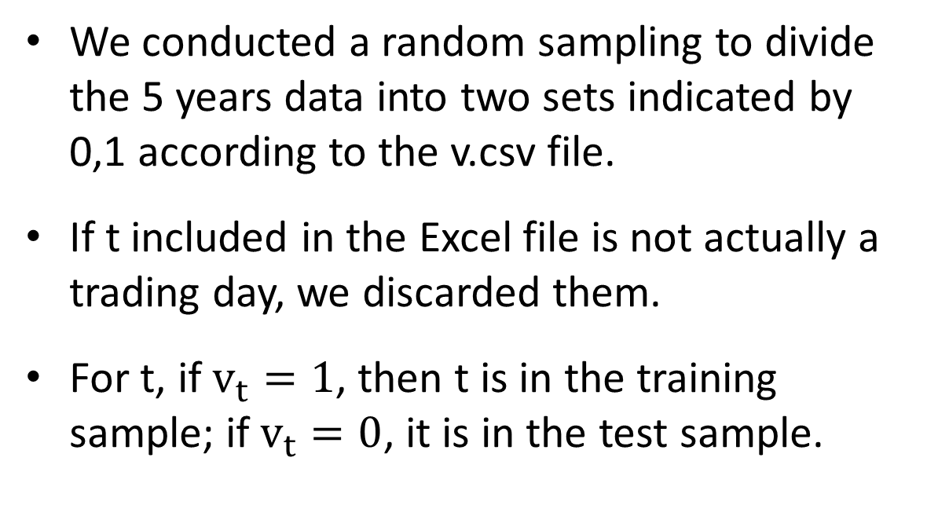
Training/Test Samples
We conducted a random sampling to divide the 5 years data into two sets indicated by 0,1 according to the v.csv file.
If t included in the Excel file is not actually a trading day, we discarded them.
For t, if $v_{t}=1$, then t is in the training sample; if $v_{t}=0$, it is in the test sample.
Methodology

Slide 7
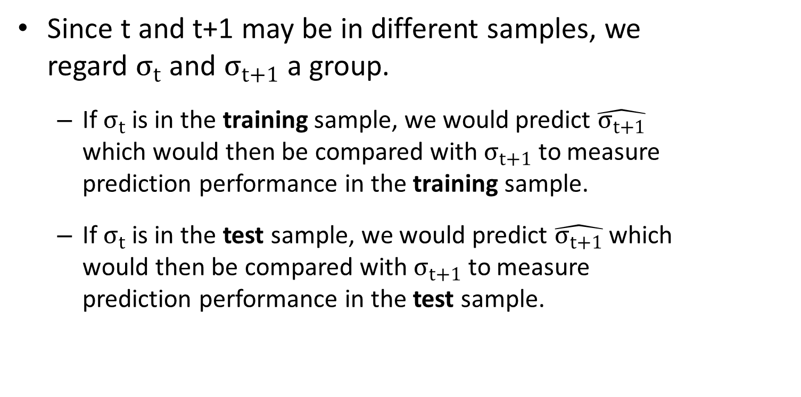
Training/Test Samples
Since t and t+1 may be in different samples, we regard $σ_{t}$ and $σ_{t+1}$ a group.
If $σ_{t}$ is in the training sample, we would predict $\hat{σ_{t+1}}$ which would then be compared with $σ_{t+1}$ to measure prediction performance in the training sample.
If $σ_{t}$ is in the test sample, we would predict $\hat{σ_{t+1}}$ which would then be compared with $σ_{t+1}$ to measure prediction performance in the test sample.
Methodology

Slide 8
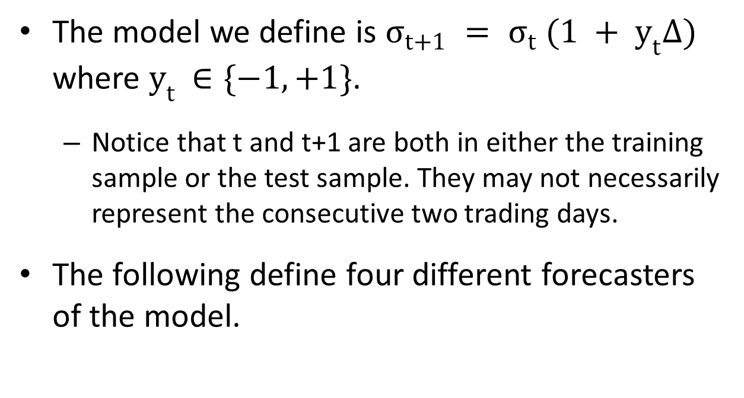

Different Forms of Forecaster $y_{t}$
The model we define is $σ_{t+1} = σ_{t} (1 + y_{t}∆)$ where $y_{t }∈\{−1,+1\}$.
Notice that t and t+1 are both in either the training sample or the test sample. They may not necessarily represent the consecutive two trading days.
The following define four different forecasters of the model.
Methodology

Slide 9

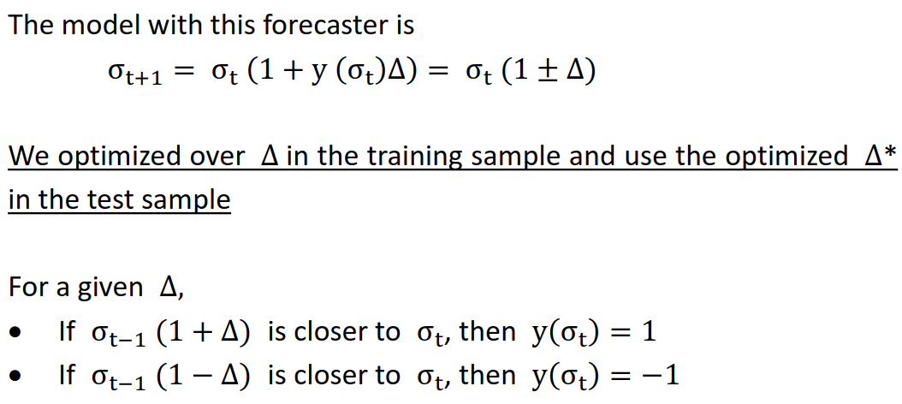

First Forecaster of $y_{t}$
Methodology

Slide 10
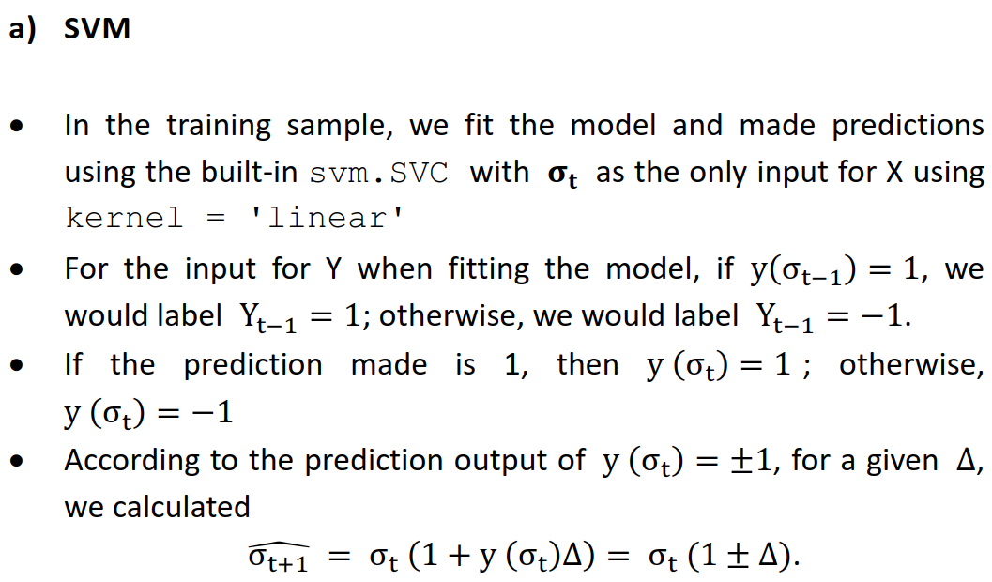
First Forecaster of $y_{t}$
Methodology

Slide 11
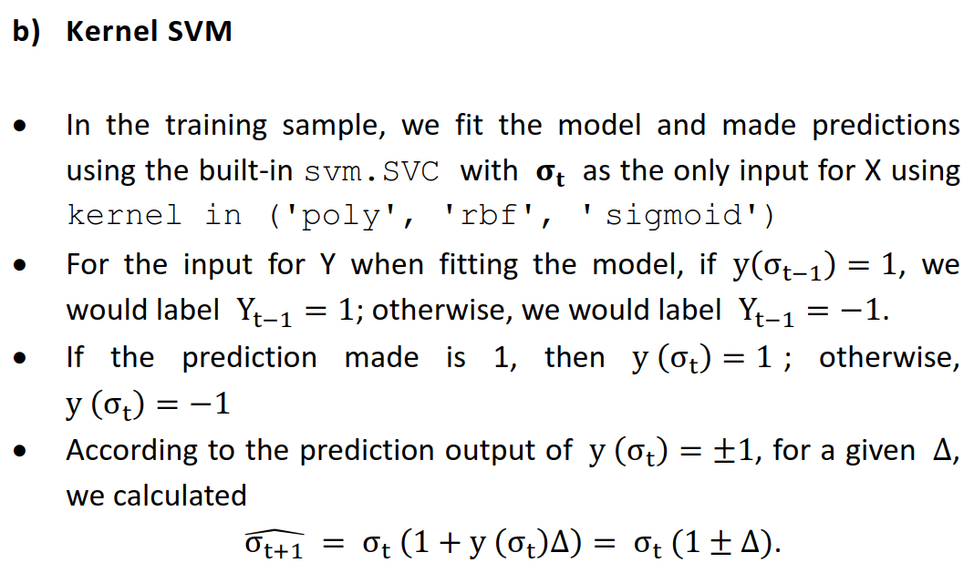
First Forecaster of $y_{t}$
Methodology

Slide 12
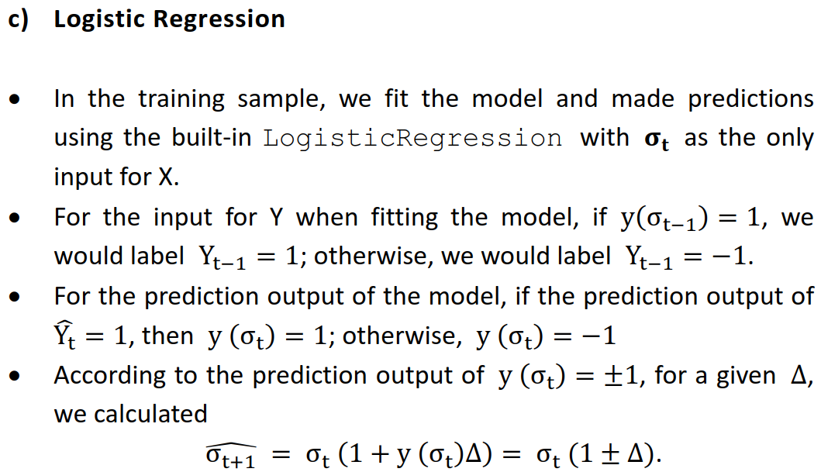
First Forecaster of $y_{t}$
Methodology

Slide 13

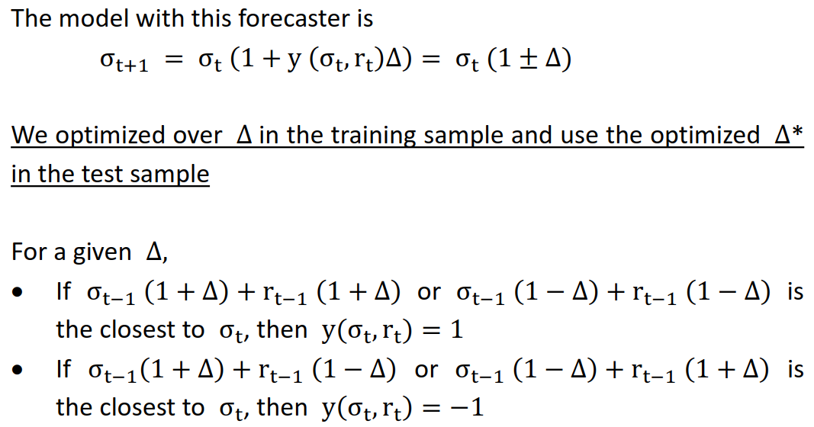

Second Forecaster of $y_{t}$
Methodology

Slide 14
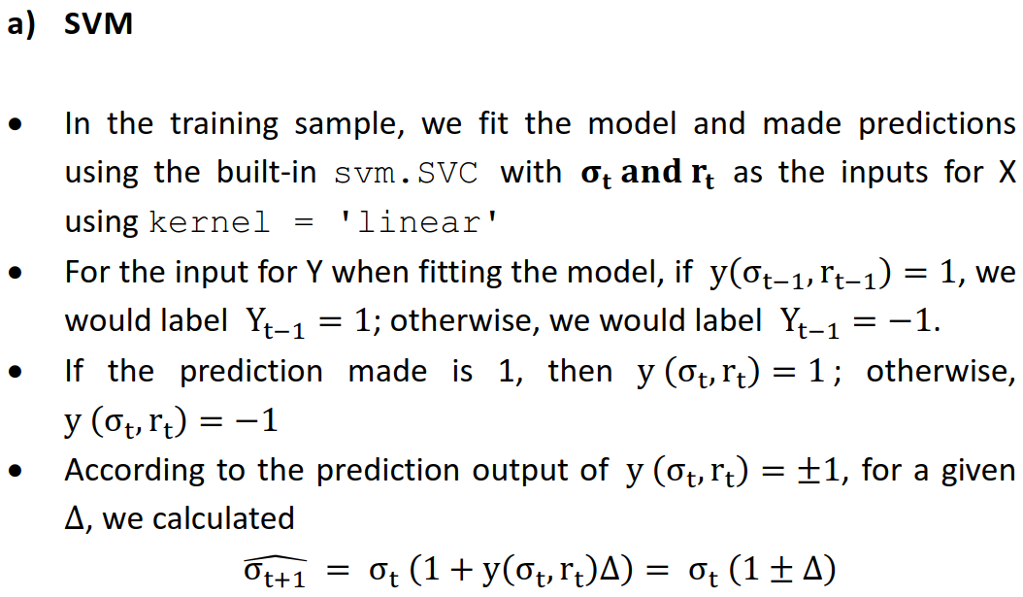
Second Forecaster of $y_{t}$
Methodology

Slide 15
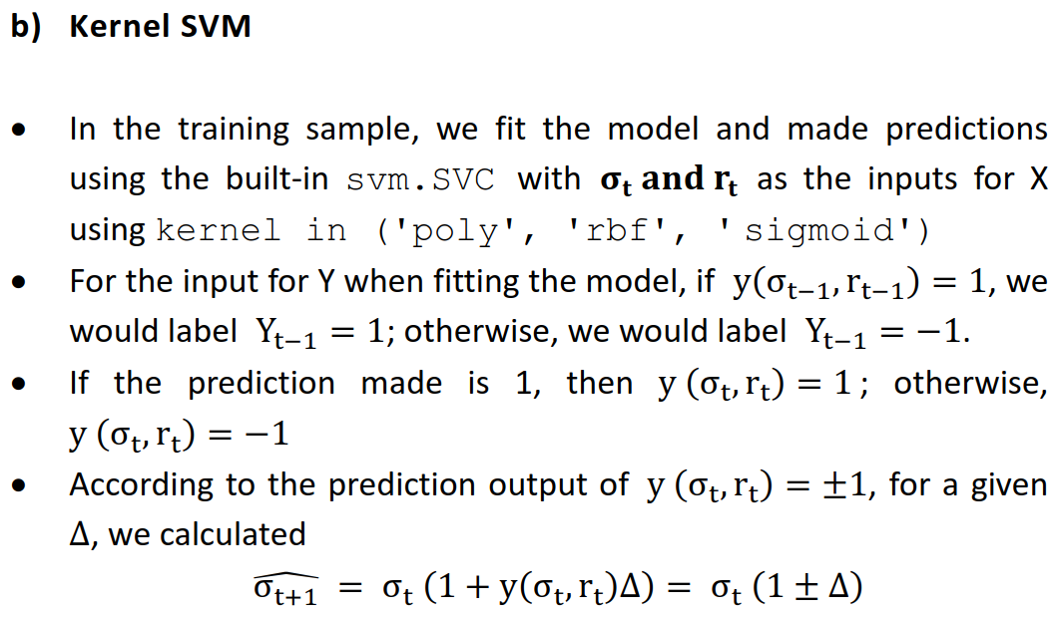
Second Forecaster of $y_{t}$
Methodology

Slide 16
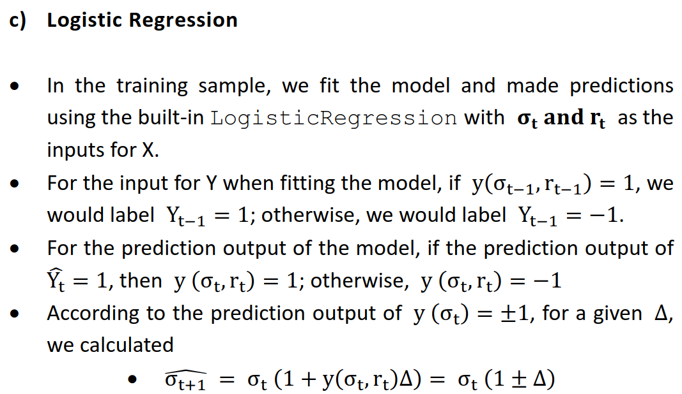
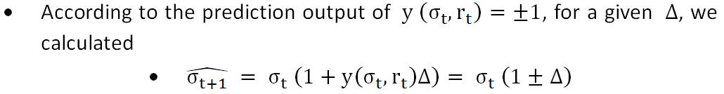
Second Forecaster of $y_{t}$
Methodology

Slide 17

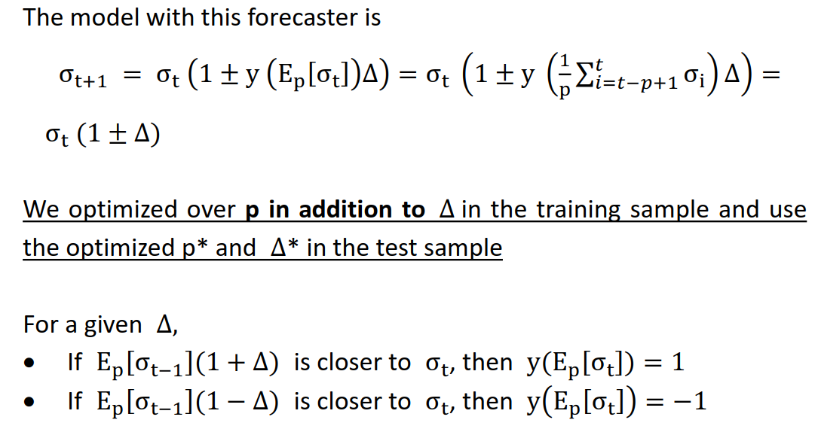

Third Forecaster of $y_{t}$
Methodology

Slide 18
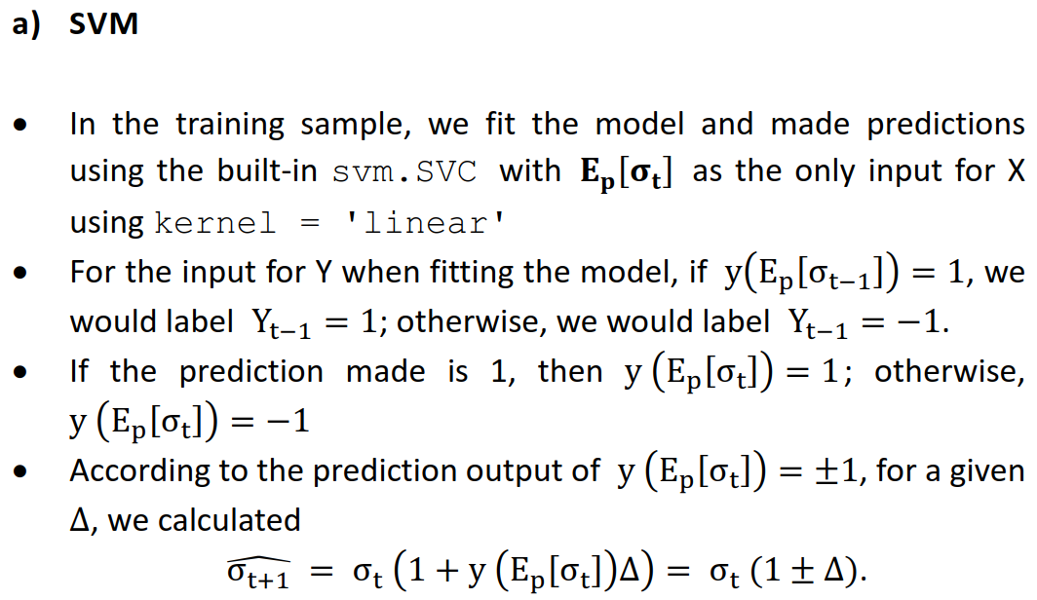
Third Forecaster of $y_{t}$
Methodology

Slide 19
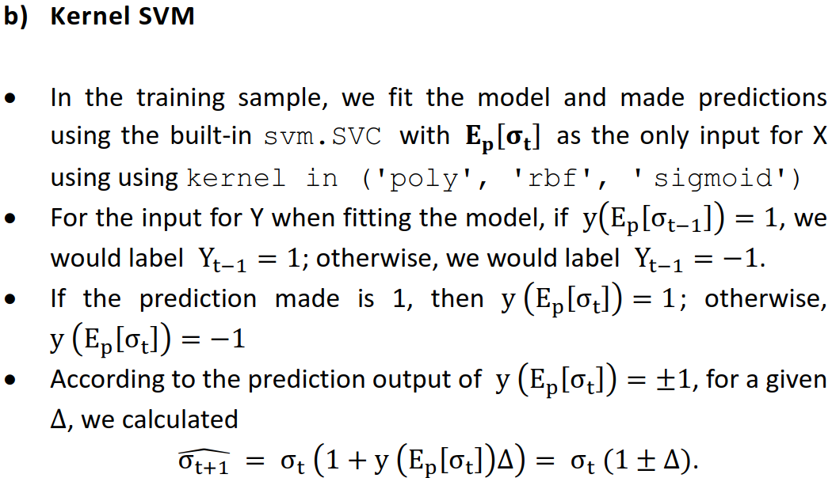
Third Forecaster of $y_{t}$
Methodology

Slide 20
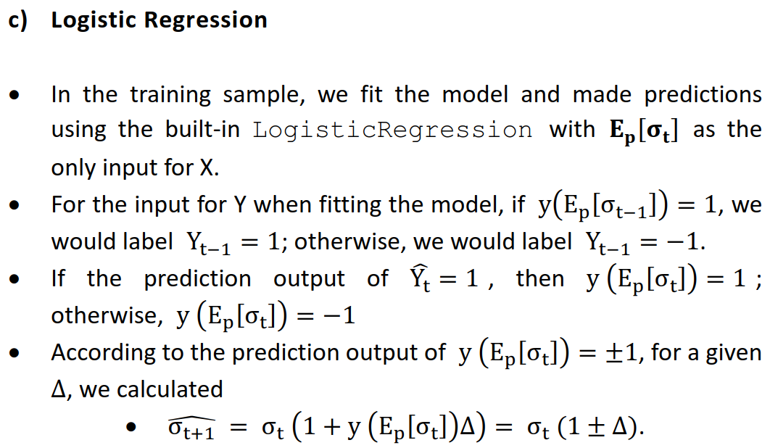
Third Forecaster of $y_{t}$
Methodology

Slide 21





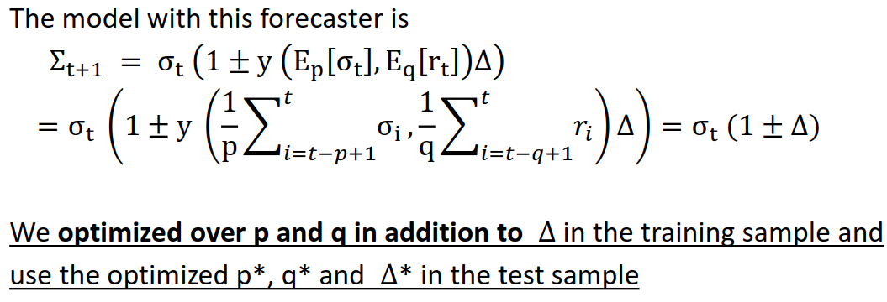
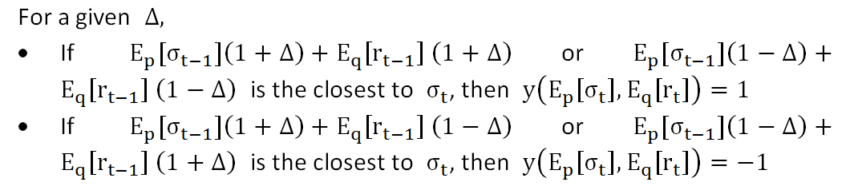

Fourth Forecaster of $y_{t}$
Methodology

Slide 22
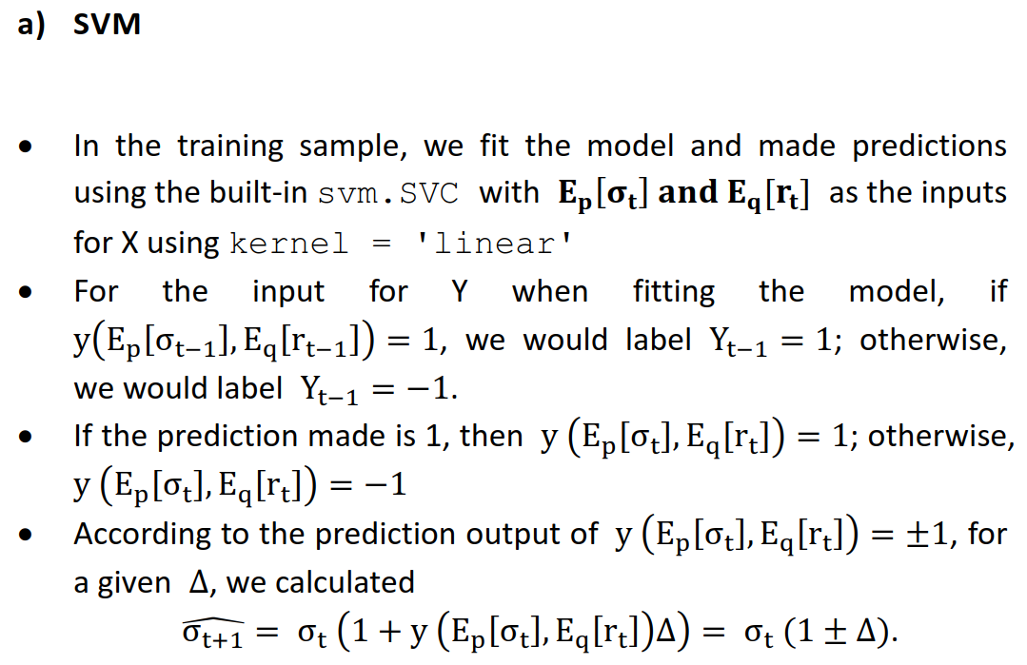
Fourth Forecaster of $y_{t}$
Methodology

Slide 23
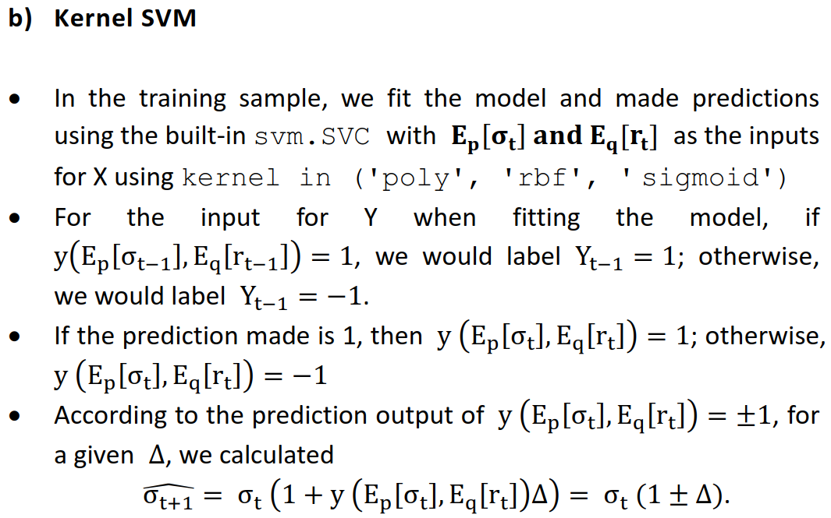
Fourth Forecaster of $y_{t}$
Methodology

Slide 24
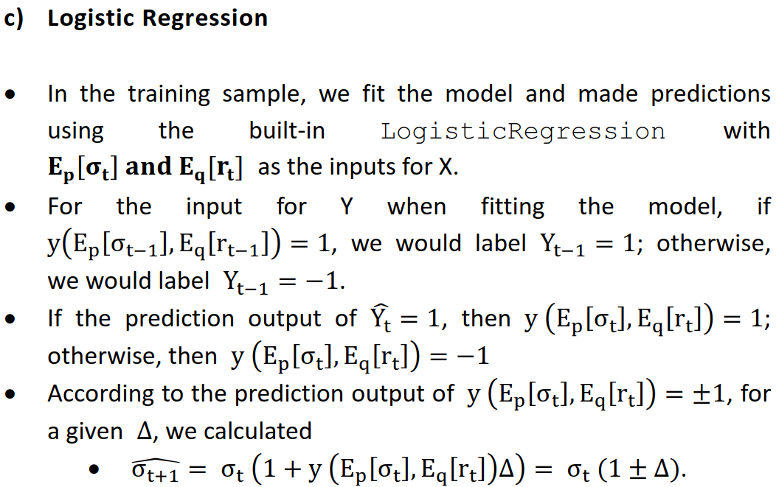
Fourth Forecaster of $y_{t}$
Methodology

Slide 25

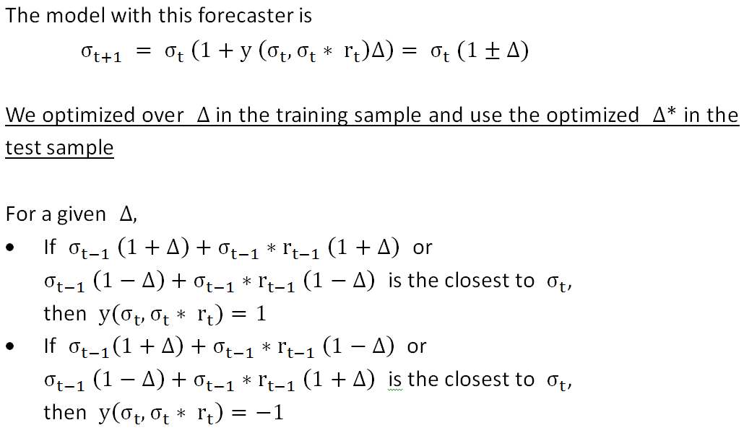

Research Problem: Fifth Forecaster of $y_{t}$
Methodology

Slide 26
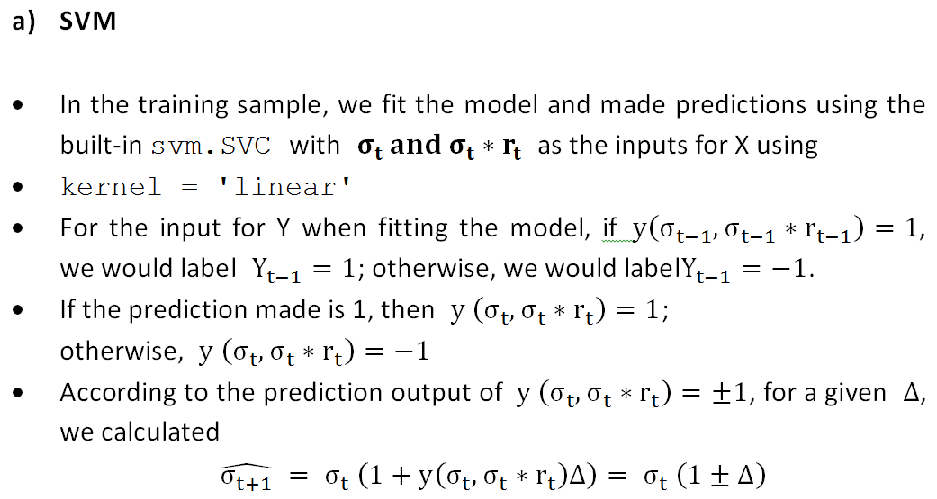
Research Problem: Fifth Forecaster of $y_{t}$
Methodology

Slide 27
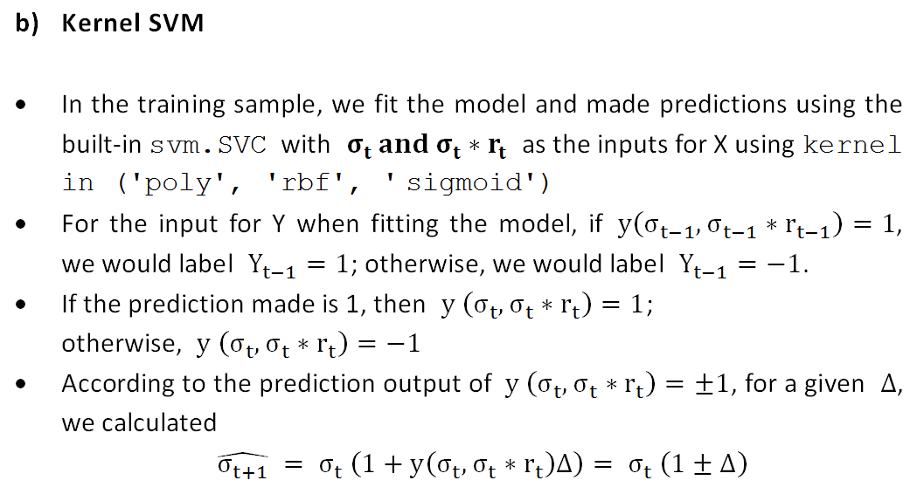
Research Problem: Fifth Forecaster of $y_{t}$
Methodology

Slide 28
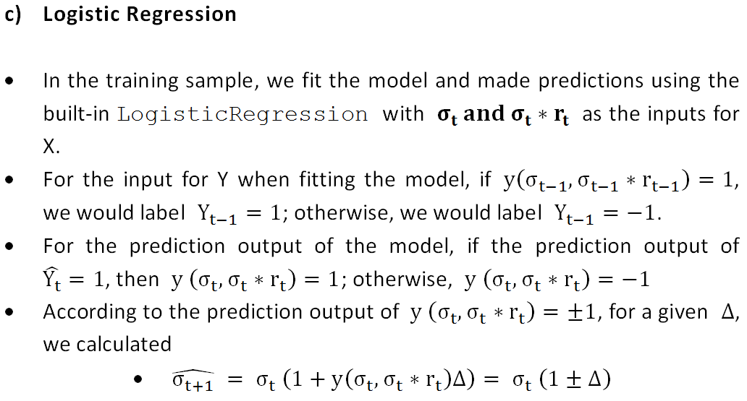
Research Problem: Fifth Forecaster of $y_{t}$
Methodology

Slide 29
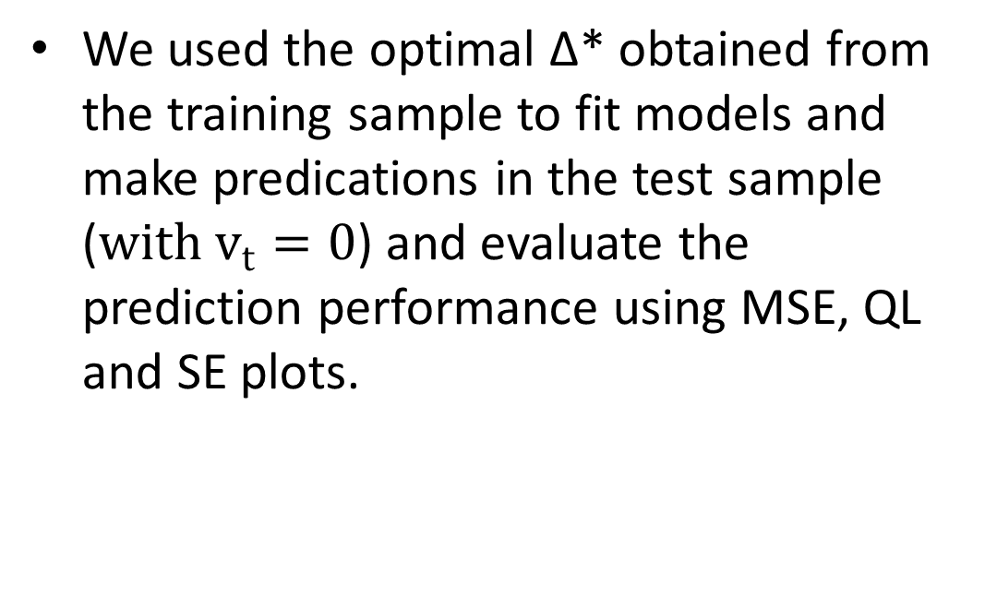
Measure Prediction Performance in the Test Sample
We used the optimal ∆* obtained from the training sample to fit models and make predications in the test sample ($with v_{t}=0$) and evaluate the prediction performance using MSE, QL and SE plots.
Methodology

Slide 30
Comparison of Prediction Performance of different Models
We obtained the sum of MSEs and QLs across all 9 currency pairs for 7 different models to measure their relative performance.
We only compared across models the performance in the test sample.
Methodology

Slide 31
Results Summary

Slide 32
Sum of MSEs/QLs (Daily)
Results Summary

Slide 33
Sum of MSEs/QLs (Daily)
Results Summary

Slide 34
Relevant Data Summary for Daily Data
Please Click Here to Get All the Relevant Data Summary for
Daily Data
Results Summary

Slide 35
Sum of MSEs/QLs (Weekly)
Results Summary

Slide 36
Sum of MSEs/QLs (Weekly)
Results Summary

Slide 37
Relevant Data Summary for Weekly Data
Please Click Here to Get All the Relevant Data Summary for Weekly Data
Results Summary

Slide 38
Key Observations
For daily data, according to the prediction performance ranked by the sum of MSE,
the prediction performance depends a lot on the types of forecasters
Forecaster 1 gave the best prediction performance, followed by Forecaster 3/5 (with similar prediction performance), Forecaster 4 and Forecaster 2
Results Summary

Slide 39
Key Observations
For daily data, according to the prediction performance ranked by the sum of MSE,
Forecaster 1 outperformed all the other models, indicating that daily volatility along would well predict daily volatility compared with other forecasters
Forecaster 2 underperformed all the other models, indicating that daily return along would not well predict daily volatility compared with other forecasters
Results Summary

Slide 40
Key Observations
For daily data, according to the prediction performance ranked by the sum of MSE,
Forecaster 3 and Forecaster 4 failed to outperform Forecaster 1, indicating that considering the moving average of daily volatility or/and daily return would worsen the prediction performance
Results Summary

Slide 41
Key Observations
For weekly data, according to the prediction performance ranked by the sum of MSE,
the prediction performance essentially depends on the types of forecasters
Forecaster 1 gave the best prediction performance, followed by Forecaster 4, Forecaster 1, Forecaster 2 and Forecaster 5
Results Summary

Slide 42
Key Observations
For weekly data, according to the prediction performance ranked by the sum of MSE,
Forecaster 3 outperformed Forecaster 1 by considering the moving average (MA) of weekly volatility rather than simply weekly volatility
MA can help smooth out noises of weekly volatility and improve prediction performance
Forecaster 4 considering the moving average of both weekly volatility and weekly return underperformed Forecaster 1but outperformed all the other forecasters.
Smoothing out the noises of weekly volatility only would be enough
Smoothing out the noises of weekly return in addition to weekly volatility would be “painting the lily”
Results Summary

Slide 43
Key Observations
For weekly data, according to the prediction performance ranked by the sum of MSE,
Forecaster 2 underperformed all the other models, indicating that weekly return along would not well predict weekly volatility compared with other forecasters
Results Summary

Slide 44
Explanation of Plots
We studied the following models in this homework:
Logistic Regression Model
SVM
Kernel SVM with the following kernels
polynomial of degree 2
polynomial of degree 3
polynomial of degree 4
polynomial of degree 5
rbf
sigmoid
Results Summary

Slide 45
Explanation of Plots
For each model:
For forecaster 1, 2 and 5, we produced for each currency pair
a plot of MSE against log(Delta) using daily data
a plot of squared error against time using daily data
a plot of MSE against log(Delta) using weekly data
a plot of squared error against time using weekly data
For forecaster 3, we produced for each currency pair
a plot of MSE against log(Delta) and p using daily data
a plot of squared error against time using daily data
a plot of MSE against log(Delta) and p using weekly data
a plot of squared error against time using weekly data
Results Summary

Slide 46
Explanation of Plots
For each model:
For forecaster 4, we produced for each currency pair
a plot of MSE against log(Delta), p and q using daily data
a plot of squared error against time using daily data
a plot of MSE against log(Delta), p and q using weekly data
a plot of squared error against time using weekly data
Results Summary

Slide 47
Explanation of Plots
3D scatter plots for forecaster 3:
x-axis: log(Delta)
y-axis: p
z-axis: MSE
4D scatter plots for forecaster 4:
x-axis: log(Delta)
y-axis: p
z-axis: q
Heat map (color): MSE
the darker the color, the higher the MSE value is
Results Summary

Slide 48
Plots of AUDUSD for Daily and Weekly data
Please Click Here to Get All the Relevant Plots of AUDUSD for Daily and Weekly Data
Results Summary

Slide 49
Plots of CADUSD for Daily and Weekly data
Please Click Here to Get All the Relevant Plots of CADUSD for Daily and Weekly Data
Results Summary

Slide 50
Plots of CHFUSD for Daily and Weekly data
Please Click Here to Get All the Relevant Plots of CHFUSD for Daily and Weekly Data
Results Summary

Slide 51
Plots of EURUSD for Daily and Weekly data
Please Click Here to Get All the Relevant Plots of EURUSD for Daily and Weekly Data
Results Summary

Slide 52
Plots of GBPUSD for Daily and Weekly data
Please Click Here to Get All the Relevant Plots of GBPUSD for Daily and Weekly Data
Results Summary

Slide 53
Plots of JPYUSD for Daily and Weekly data
Please Click Here to Get All the Relevant Plots of JPYUSD for Daily and Weekly Data
Results Summary

Slide 54
Plots of NOKUSD for Daily and Weekly data
Please Click Here to Get All the Relevant Plots of NOKUSD for Daily and Weekly Data
Results Summary

Slide 55
Plots of NZDUSD for Daily and Weekly data
Please Click Here to Get All the Relevant Plots of NZDUSD for Daily and Weekly Data
Results Summary

Slide 56
Plots of SEKUSD for Daily and Weekly data
Please Click Here to Get All the Relevant Plots of SEKUSD for Daily and Weekly Data
Results Summary

